Slide 1

Lecture – 8/23/2016
CSCI 36300 – Software Design

Slide 2
General Course Information
Lecture:
Tuesday/Thursday 10:30 AM – 11:45 AM (LD004)
Instructor:
Ryan Rybarczyk
rrybarcz@cs.iupui.edu
Office:
SL 263
Office Hours:
Tuesday/Thursday 1:30 PM – 3:00 PM
By Appointment
TA:
Zach Reynolds
zpreynol@imail.iu.edu

Slide 3
Syllabus
Canvas

Slide 4
Quiz #1

Slide 5
Course Overview

Slide 6

Course Overview
Gang of Four (GoF) Book
Erich Gamma
Richard Helm
Ralph Johnson
John Vlissides
23 Classic Software Design Patterns
A general knowledge of good software design practices.
Not a complete reference but a great foundation!
We will use this textbook in a non-traditional fashion.

Slide 7
Course Overview
We may have additional readings (papers, articles, etc.) throughout the semester – I will provide access to these resources.
Periodic discussions will take place on Canvas – I will also post answers to questions asked by students there. Please make sure to check there before contact me or the TA as the question may have already been asked and answered.
Assignments must be submitted on time – no late work will be accepted.
Do not wait until the last minute to start your assignment.
All work submitted must be your own!

Slide 8
Course Overview
Participation is a vital part of this course.
10% of your final grade.
This does not mean you can just show up and receive an automatic free 10%.
I expect active participation in class.
I may periodically call on students – please be prepared and attentive during lecture.

Slide 9
Course Overview
Assignments:
5 Total Assignments
Each will build upon the last – it is imperative that you make any necessary corrections moving forward.
Grading Rubric:
40% execution correctness
30% structure (e.g., modularization, information hiding, etc.)
10% insightful programming (e.g., developing reusable class components, etc.)
10% consistent style (e.g., capitalization, indenting, etc.)
10% appropriate commenting style

Slide 10
Course Overview
We will focus and explore object-oriented techniques that will help highlight how to build software architectures that decouple interdependencies between components.
Work smarter! (not harder…)
We will be using C++ in this course.
Why?
C++ provides us a more in-depth look at how/why/when software design patterns should be used.
Java does a lot of this work for us under the “hood.”

Slide 11
Course Overview
The goal of this course is to study best practices in designing and implementing object-oriented systems of high quality.
Established design patterns and practices will be taught in an effort to demonstrate good examples for software designs.
Discussion of these design patterns will allow us to clearly articulate design tradeoffs.
How, What, Where, and Why

Slide 12
Course Overview
We will attempt to address the following concrete areas in this course through the use of object-oriented techniques:
Decentralized software architecture
Architectural and design patterns
Class interface definition
Component reuse
Module decomposition
Hierarchical classification
Extensible object-oriented application frameworks

Slide 13
Introduction

Slide 14
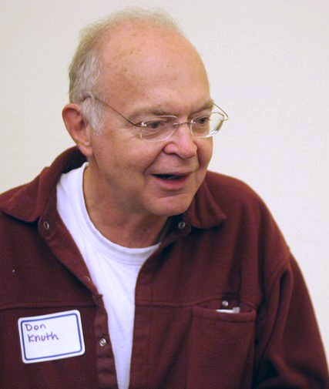
Introduction
Designing Object-Oriented (OO) software is not easy!
Designing reusable OO software is really hard!
Why?
“…software is hard. It’s harder than anything else I’ve ever had to do.”
– Donald Knuth

Slide 15
Object-Oriented Paradigm
Objects – Software Objects
Perform task – collect data
Objects “talk” to one another
Components of an overall system.
Typical program organization:
Classes
Inheritance
Hierarchies
Code Reuse

Slide 16
OO Approach Features
Natural way of thinking
Reuse
Real-world examples
Information Hiding
Stages or phases of development
Check-pointing

Slide 17
OO Approach Benefits
Faster Development
Ease of Use
Extendibility
Reuse
Rapid Prototyping
Check Pointing
Design Patterns – “Building Blocks”

Slide 18
Object-Oriented Concepts
Basic Object-Oriented Concepts
Object
Class
Attribute
Operation
Interface (Polymorphism)
Component
Package
Relationships

Slide 19
Object-Oriented Programming
Principles of OOP
Find the nouns → objects/state
Find the verbs → behaviors - methods/functions
Encapsulation, Inheritance
Programming + Documentation
How do we design software systems to encompass these principles?

Slide 20
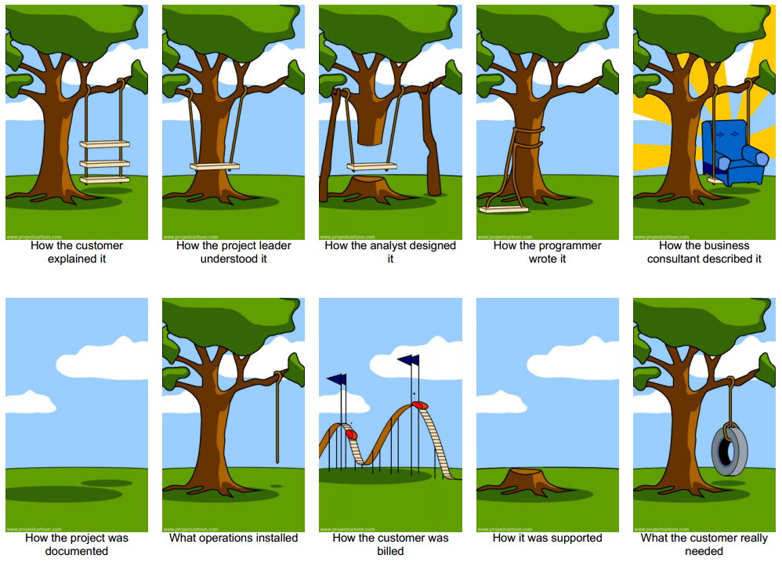

Slide 21
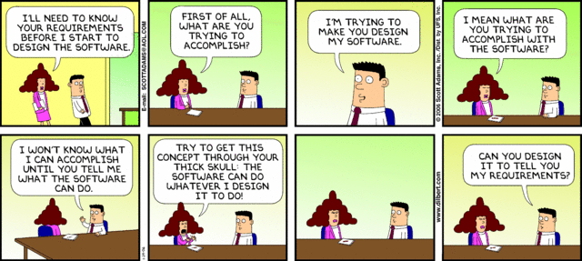

Slide 22
Object-Oriented Programming
Four Pillars of Object-Oriented Programming:
Encapsulation
Data Hiding
Inheritance
Polymorphism

Slide 23
Introduction
Typically, experienced software designers make good design decisions.
At the same time it typically takes a novice a long time to learn and acquire the skills to provide good OO designs.
What is the secret?

Slide 24
Introduction
Experienced software designers know that you don’t have to solve every problem from scratch!
Reuse solutions that have worked in the past – build upon previously learned concepts.
Avoid making the same mistakes twice.
Where does that leave us…?

Slide 25


Slide 26
Pattern Overview

Slide 27
Introduction
Pattern - the regular and repeated way in which something happens or is done.
-Webster Dictionary

Slide 28
Patterns
What does a pattern do?
Documents a recurring problem/solution paring within a given context.
Problem/Solution binding – how they are related.
Recurrence is the key!
Note the use of the word context.
Patterns vs. Experience
Documented & Shared

Slide 29

Patterns
Architectural Patterns
Engineering Domain
Blueprints
Pattern Language
Different levels of scale.
City/Neighborhood – how they are connected and interact.
Solutions drawn from experience that were then documented.

